Slide 1
HTML
The ‘M’ is for MARKUP

Slide 2
What is HTML?

Slide 3

HTML
Is the code that allows us to build websites: HyperText Markup Language

Slide 4
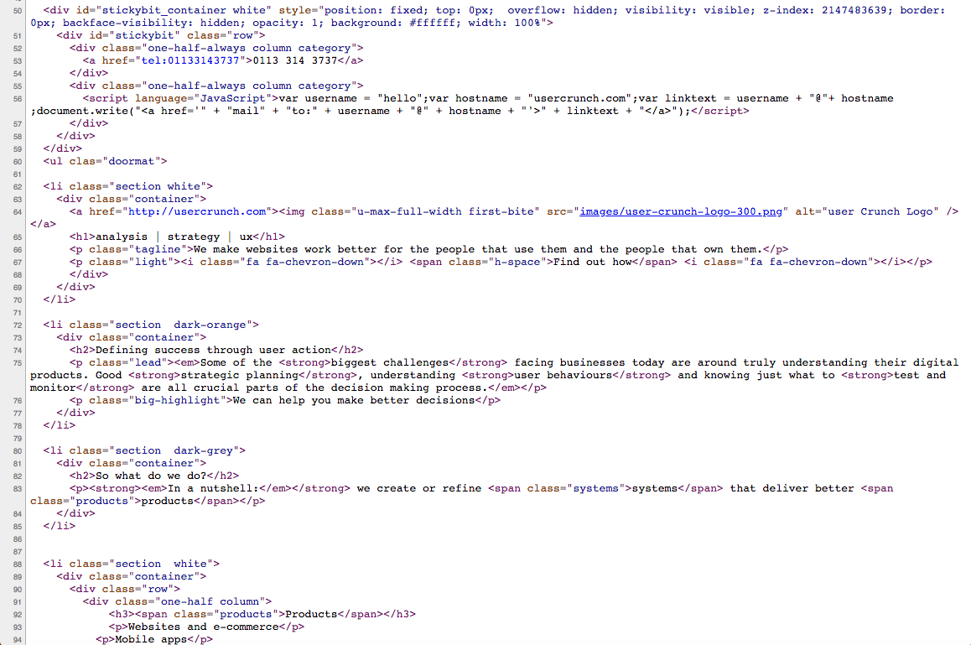
Source Code
If you right click on a website and choose ‘view source’ you’ll see something like this.
Go ahead and try it

Slide 5
HISTORY
Invented by Tim Berners-Lee
Hypertext started as a way to link between scientific papers as they referred to another
First web page built August 6 1991
The w3 Consortium are in charge of the standardisation of HTML (The Rules)

Slide 6
HISTORY
V1 - early 1990s
HTML4 in 1997
XHTML in 2000
HTML5 in 2014

Slide 7
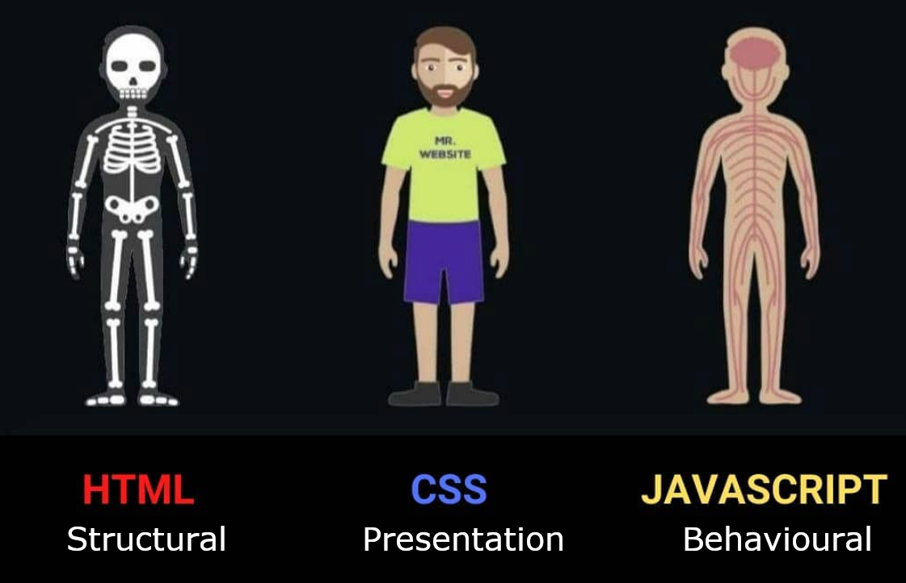
Anatomy of a website
Your Content
Plus HTML for structure
Plus CSS for presentation Equals
YOUR WEBSITE
We use HTML and CSS to give form and style to the content

Slide 8
Example (Just Text)
Hello world! This is example text showing how HTML and CSS work together to apply structure and presentation layer to content. This content would probably look better if it was a bit more spaced out and if certain key words or phrases were highlighted - maybe by making them a different colour?

Slide 9
Example (with structure)
<h2>Hello world!<h2>
<p>This is example text showing how <strong>HTML</strong> and <strong>CSS</strong> work together to apply structure and presentation layer to content.</p>
<p>This content would probably look better if it was a bit more spaced out and if certain key words or phrases were highlighted - maybe by making them a <em>different colour</em>?</p>

Slide 10
Example + HTML
Hello world!
This is example text showing how HTML and CSS work together to apply structure and presentation layer to content.
This content would probably look better if it was a bit more spaced out and if certain key words or phrases were highlighted - maybe by making them a different colour?
STRUCTURE (Adding paragraphs and bold text with HTML)

Slide 11
Example + HTML + CSS
Hello world!
This is example text showing how HTML and CSS work together to apply structure and presentation layer to content.
This content would probably look better if it was a bit more spaced out and if certain key words or phrases were highlighted - maybe by making them a different colour?

Slide 12
Anatomy of a website
A paragraph is your content
Putting your content into an HTML tag to make it look like a paragraph is structure
<p>A paragraph is your content</p>
Making the font of your paragraph green and 24px is presentation A paragraph is your content

Slide 13
Anatomy of an html element
Element
An individual component of HTML
Paragraph, heading, table, list, div, link, image, etc.
Tag
Marks the beginning & end of an element
Opening tag and Closing Tag
Tags contain characters that indicate the tag's purpose
<tagname>Stuff in the middle</tagname>
<p> This is a sample paragraph.</p>

Slide 14
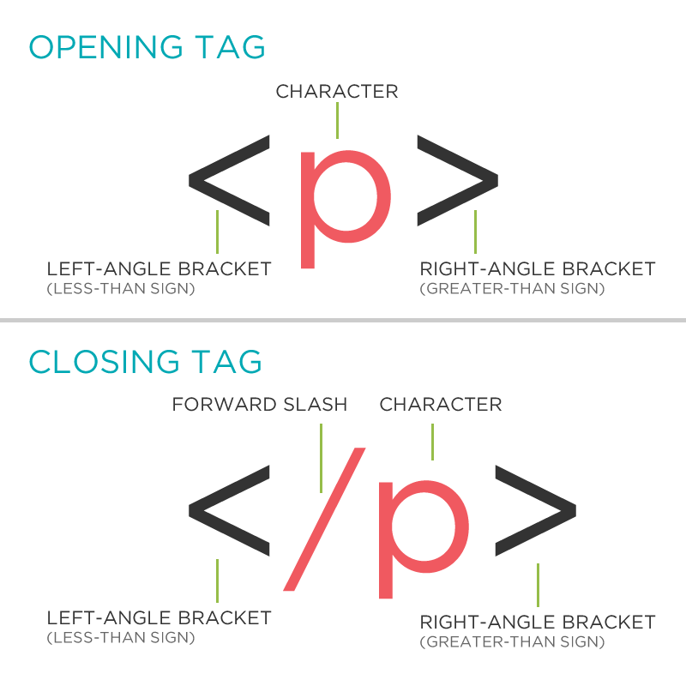
Tag Breakdown

Slide 15
Task 2.1.1
Student:
Create a folder called module-2
In the module-2 folder create Task-2.1.1.html
Teacher Demo :
Take the content from previous slides
And add structure to content
Together :
Commit the change
Push to remote
Part 1 - Assisted Task
Working in repo:
LTU-Reboot Digital Coding
Notes:
Paste into chat to use:
Hello world! This is example text showing how HTML and CSS work together to apply structure and presentation layer to content. This content would probably look better if it was a bit more spaced out and if certain key words or phrases were highlighted - maybe by making them a different colour?
For Instructor
With Structure:
<h2>Hello world!<h2>
<p>This is example text showing how <strong>HTML</strong> and <strong>CSS</strong> work together to apply structure and presentation layer to content.</p>
<p>This content would probably look better if it was a bit more spaced out and if certain key words or phrases were highlighted - maybe by making them a <em>different colour</em>?</p>

Slide 16
Anatomy of an html element
Container Element
An element that can contain other elements or content
A paragraph (<p>) contains text
Stand Alone Element
An element that cannot contain anything else
<br />
<img />

Slide 17
Anatomy of an html element
Attribute
Provides additional information about the HTML element
Class, ID, language, style, identity, source
Placed inside an opening tag, before the right angle bracket.
Value
Value is the value assigned to a given attribute.
Values must be contained inside quotation marks.
<div id="copyright">© LTU logo 2020</div>
<img src="my_picture.jpg" />
<a href="https://www.leedstrinity.ac.uk/">Leeds Trinity Uni</a>

Slide 18
Doctype
The first thing on an HTML page is the doctype, which tells the browser which version of the markup language the page is using.
<!DOCTYPE HTML PUBLIC "-//W3C//DTD HTML
4.01 Transitional//EN" "http://
www.w3.org/TR/html4/loose.dtd">
<!DOCTYPE html>
* The doctype is case-insensitive. DOCtype, doctype, DocType and DoCtYpe are all valid.
Notes:
A Document Type Declaration, or DOCTYPE for short, is an instruction to the web browser about the version of markup language in which a web page is written.
A DOCTYPE declaration appears at the top of a web page before all other elements. According to the HTML specification or standards, every HTML document requires a valid document type declaration to insure that your web pages are displayed the way they are intended to be displayed.
The doctype declaration is usually the very first thing defined in an HTML document (even before the opening <html> tag); however the doctype declaration itself is not an HTML tag.
The DOCTYPE for HTML5 is very short, concise, and case-insensitive.

Slide 19
HTML Tag
After <doctype>, the page content must be contained between <html> tags.
<!DOCTYPE html>
<html>
</html>

Slide 20
Head and Body Tags
<!DOCTYPE html>
<html>
<head>
<title>Title of the page </title>
</head>
<body>
The page content here.
</body>
</html>

Slide 21
Task 2.1.2
Student:
In Module-2 : create Task-2.1.2.html
Teacher Demo :
Let's get our web page set up with a doctype, head, title and body.
Add text from task 2.1.1.html
Together :
Commit the change
Push to remote
Part 1 - Assisted Task
Working in repo:
LTU-Reboot Digital Coding

Slide 22
Nesting
All elements "nest" inside one another
Nesting is what happens when you put other containing tags inside other containing tags. For example, you would put the <p> inside of the <body> tags. The <p> is now nested inside the <body>

Slide 23
Whichever element OPENS first CLOSES last

Slide 24
Nesting Example
Elements are 'nested' inside the <body> tag.
<body>
<p>A paragraph inside the body tag</p>
</body>
Paragraphs 'nested' inside list items.
<ul>
<li>
<p>A paragraph inside a list item</p>
</li>
</ul>

Slide 25
Element: Paragraph
<p>Paragraph 1</p>
<p>Paragraph 2</p>
<p>Paragraph 3</p>
Paragraph 1
Paragraph 2
Paragraph 3
<p>Paragraph 1</p> <p>Paragraph 2</p> <p>Paragraph 3</p>
<p>Paragraph 1</p>
<p>Paragraph 2</p>
<p>Paragraph 3</p>
* White space is only for humans. You can write your code with any spacing.

Slide 26
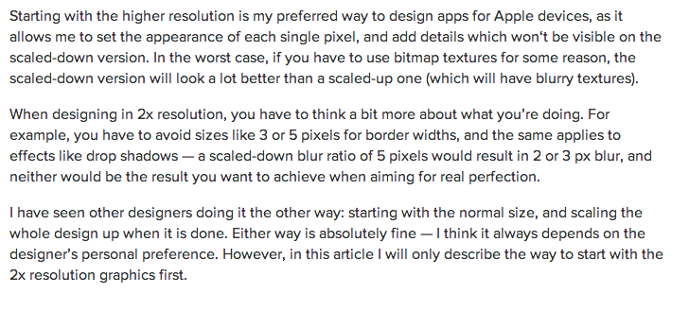
Example: Paragraphs
Paragraphs allow you to format your content in a readable fashion.
* You can edit how paragraphs are displayed with CSS

Slide 27
Element: Headings
Heading 1
Heading 2
Heading 3
Heading 4
Heading 5
Heading 6
<h1>Heading 1</h1>
<h2>Heading 2</h2>
<h3>Heading 3</h3>
<h4>Heading 4</h4>
<h5>Heading 5</h5>
<h6>Heading 6</h6>
* Heading number indicates hierarchy, not size.

Slide 28
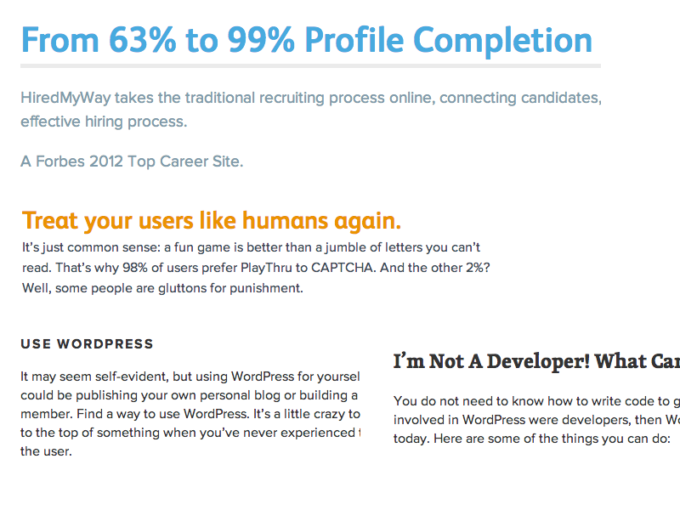
Element: Headings

Slide 29
Formatted text
<p>
Here is a paragraph with <em>emphasized</em> text and <strong>important</strong> text.
</p>
Here is a paragraph with Emphasized text and Important text.
* Notice: em and strong are meant to indicate meaning through style. If you want to have italicized for appearance and not to communicate meaning, you should use CSS.

Slide 30
Task 2.1.3
Student:
In module-2 folder : create Task-2.1.3.html
Set up with a doctype, head, title and body.
Let's add some content to our sites.
Add one of each level of heading with 1-2 short paragraphs of text below each heading.
Use <strong> and <em> within a few paragraphs.
Together :
Commit the change
Push to remote
Working in repo:
LTU-Reboot Digital Coding

Slide 31
Element: Link
Links have three components
Tag: <a></a>
Href attribute: "https://leedstrinity.ac.uk"
Title attribute: "Leeds Trinity University - Frontpage"
<a href="https://leedstrinity.ac.uk" title="Leeds Trinity University - Frontpage">Leeds Trinity University</a>
Leeds Trinity University
The <a> tag surrounds text or images to turn them into links

Slide 32
Link Attributes
Links can have attributes that tell the link to do different actions like open in a new tab, or launch your e-mail program.
<a href="home.html" target="_blank">Link Text</a>
Link opens in a new window/tab with target="_blank"
<a href="mailto:hello@leedstrinity.ac.uk">E-mail us!</a>
Adding mailto: directly before the email address means the link will open in the default email program.

Slide 33
Relative vs. Absolute paths for links & images
Relative
Relative paths change depending upon the page the link is on.
Links within the same directory need no path information. "filename.jpg"
Subdirectories are listed without preceding slashes. "img/filename.jpg"
Absolute
Absolute paths refer to a specific location of a file, including the domain. "https://www.leedstrinity.ac.uk/postgraduate/"
Typically used when pointing to a link that is not within your own domain.

Slide 34
Task 2.1.4
Student:
In Module-2 : create Task-2.1.4.html
Set up with a doctype, head, title and body.
Let's add some content to our sites.
Add links that open in the same window, a new window and link to an e-mail address.
Together :
Commit the change
Push to remote
Working in repo:
LTU-Reboot Digital Coding

Slide 35
Element: Image
Images have three components
Tag: <img />
Src attribute: "https://www.leedstrinity.ac.uk/media/site-assets/images/heros/postgraduate-hero-1.webp"
Alt attribute: "A postgraduate student listening during a class."
<img src="/media/site-assets/images/heros/postgraduate-hero-1.webp" alt="A postgraduate student listening during a class."/>
* Notice: This tag is our first example of a stand-alone or "self-closing" element.

Slide 36
Element: Line Break
<p>
Imagine there's no Heaven <br/>It's easy if you try <br/> No hell below us <br/> Above us only sky
</p>
Imagine there's no Heaven
It's easy if you try
No hell below us
Above us only sky

Slide 37
Task 2.1.5
Student:
Create Task-2.1.5.html
Set up with a doctype, head, title and body.
Let's add some images and line breaks to our page.
We can even turn our images into links.
Together :
Commit the change
Push to remote
Working in repo:
LTU-Reboot Digital Coding

Slide 38
Element: Unordered and ordered lists
<ul>
<li>List Item</li>
<li>AnotherList Item</li>
</ul>
Unordered list (bullets)
List Item
Another List Item
Ordered list (sequence)
List Item
Another List Item
<ol>
<li>List Item</li>
<li>AnotherList Item</li>
</ol>

Slide 39
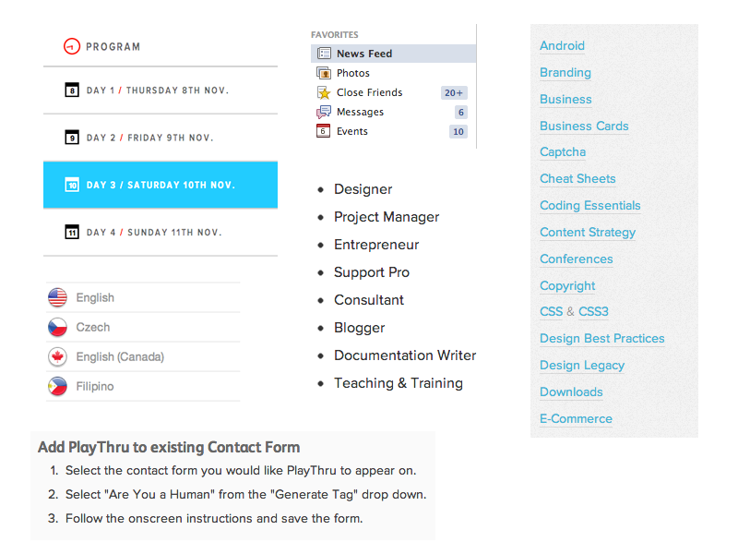
Lists: Examples
Lists can be used to organize any list of items.
You'd be surprised how often lists
are used in web design.

Slide 40
Task 2.1.6
Student:
Create Task-2.1.6.html
Set up with a doctype, head, title and body.
Let's add some content to our sites.
Let's add one of each ordered and unordered lists to our page.
We can make a list of links or even a list of images!
Together :
Commit the change
Push to remote

Slide 41
Comments
You can add comments to your code that will not be seen by the browser, but only visible when viewing the code.
<!-- Comment goes here -->
Comments can be used to organize your code into sections so you (or someone else) can easily understand your code. It can also be used to 'comment out' large chunks of code to hide it from the browser.
<!-- Beginning of header -->
<div id="header">Header Content </div>
<!-- End of header -->
<!--
<ol>
<li>List Item</li>
<li>Another List Item</li>
</ol>
-->

Slide 42

Tables
Tables are a way to represent complex information in a grid format.
Tables are made up of rows and columns.
<table>
<tr>
<th>Head</th>
<th>Head</th>
</tr>
<tr>
<td>Data</td>
<td>Data</td>
</tr>
</table>

Slide 43
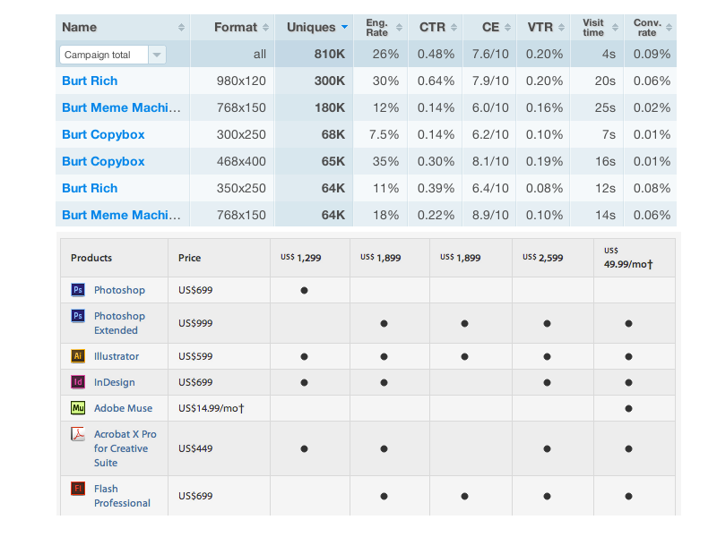
Tables: Examples
Tables can be styled with CSS to add zebra striping or to highlight important rows/columns.

Slide 44

Take away Tasks
Update:
<NAME>-CPD.html
Add a reflection of today’s lesson in your CPD
Commit and Push your changes
Bonus:
w3schools HTML QUIZ - take a screenshot of your results, this can be added to your CPD

Slide 45
Questions?

